Slide 1
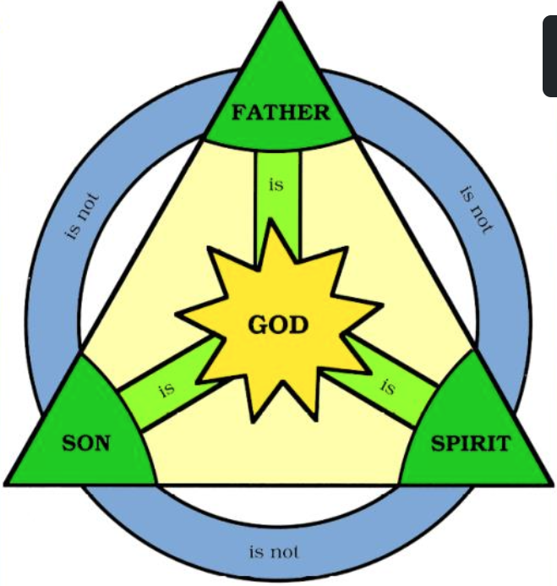
Wonderful Merciful Savior
奇妙仁慈救主
By Selah

Slide 2
Wonderful Merciful Savior 1/3
Wonderful, merciful Savior
Precious Redeemer and Friend
Who would have thought that a Lamb could
rescue the souls of men
Oh, You rescue the souls of men.
奇妙 仁慈的救主, 宝贵的救赎主和恩朋
谁会想到羔羊 可以拯救人类的灵魂
哦, 你拯救了人类的灵魂(x2)

Slide 3
Wonderful Merciful Savior 2/3
Counselor, Comforter, Keeper,
Spirit we long to embrace
You offer hope when our hearts have
hopelessly lost our way
Oh, we've hopelessly lost the way
训慰师,保惠师,守护者,我们渴望的圣灵
当我们绝望时 祢给我们的心带来希望
哦，我们无可救药地迷失了方向 (x2)

Slide 4
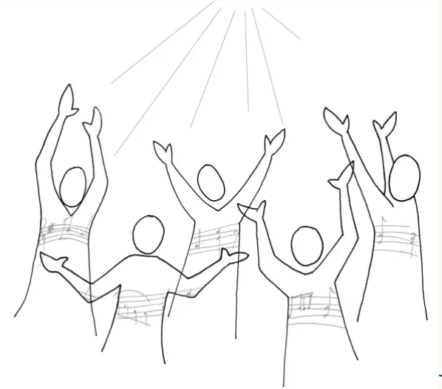
Wonderful Merciful Savior Chr.
You are the One that we praise
You are the One we adore
You give the healing and grace our
hearts always hunger for
Oh, our hearts always hunger for
祢是我们赞美的那位神
祢是我们敬拜的那位神
祢赐医治和恩典
我们的心永远渴望 (x2)

Slide 5
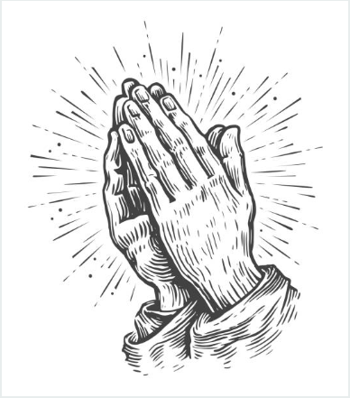
Wonderful Merciful Savior 3/3
Almighty, infinite Father
Faithfully loving Your own
Here in our weakness You find us
falling before Your throne
Oh, we're falling before Your throne
全能无量的父神,信实地爱属祢的子民
在我们软弱时 祢寻找我们
哦, 我们俯伏在祢宝座前(x2).

Slide 6
Wonderful Merciful Savior Chr.
You are the One that we praise
You are the One we adore
You give the healing and grace our
hearts always hunger for
Oh, our hearts always hunger for
祢是我们赞美的那位神
祢是我们敬拜的那位神
祢赐医治和恩典
我们的心永远渴望 (x2)

Slide 7
Wonderful Merciful Savior Chr.
You are the One that we praise
You are the One we adore
You give the healing and grace our
hearts always hunger for
Oh, our hearts always hunger for
祢是我们赞美的那位神
祢是我们敬拜的那位神
祢赐医治和恩典
我们的心永远渴望 (x2)

